Slide 1


Handling the media
Presented by:
Joanne Magley
Community Information Director
Volusia County Government

Slide 2
About me
Volusia County Government – 9 years
Florida Hospital Memorial Medical Center – 5 years
WESH 2 News – 1 year
WYTV News (Youngstown, OH) – 4 years
WEWS News (Cleveland, OH) – 2 years

Slide 3



The media’s role
• Perception of media?
• Paint image of incident to public
• Create perception of the agency and its response to incident
•Media is ONE of your organization’s link to the public before, during and after an incident.

Slide 4
Building relationships
• First Amendment
• Freedom of
Information Act
•Sunshine laws

Slide 5
Building relationships with the media
• Media is ONE conduit to the public
• Develop good relationships BEFORE an incident
  •Planned releases regarding new technology, human interest stories, etc.
  • Tour of facility/ shadowing

Slide 6
Building relationships
•Be accessible; return emails and calls promptly
  • Treat all media fairly
  •Learn and respect deadlines

Slide 7
Chain of command
•Are you authorized to speak to the media?
• Is your supervisor aware of potential media issue?

Slide 8
Do’s and Don’ts for on-camera
•DO
  •Know your main point and stick with it
  •Know what you want to say
  • Look professional; staff shirt

Slide 9
Do’s and Don’ts for on-camera
•DON’T
  •Speculate
  • Answer hypothetical questions
  •Comment on other organizations or what others have said
  • Say anything to a reporter you don’t want to see in print or on TV
  • Use “off the record”
  •Say “no comment”

Slide 10

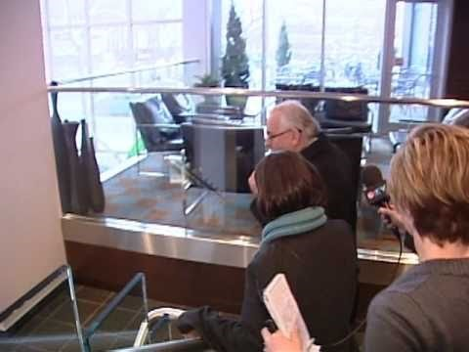
Don’ts for on-camera

Slide 11

Don’ts for on-camera

Slide 12
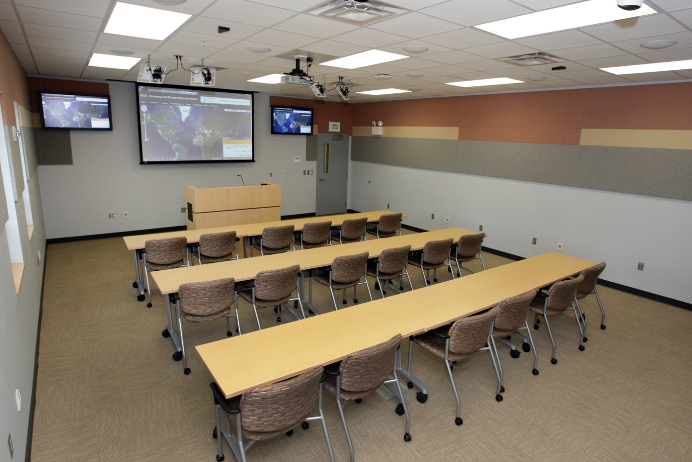
Managing your nervousness
•Prepare
•Anticipate questions
• Do something to relax yourself
•Realize the reporter wants you to succeed
•Know it’s OK to pause to gather thoughts

Slide 13
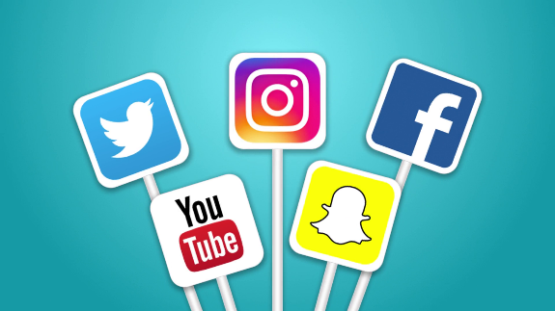
Social Media
•Widely used by all – media, residents, businesses
•Anyone with access can read and respond
•Live news can happen with cell phones
Source: FEMA.gov
Notes:
Reverse fashion: Traditional media was command and control, and in one direction. Today, people distribute and share the news
More widely used especially by Millennials, who comprise nearly 75 million or ¼ of the U.S. population. There are more Millennials today than there are Baby Boomers, and it won’t be long before Millennials dominate the U.S. workforce.
It’s FREE: Anybody with a smart device or computer has access. It’s estimated that nearly 80% of the U.S. population has a social media profile (statista.com, 2018).
Multi-directional between different SM platforms.

Slide 14

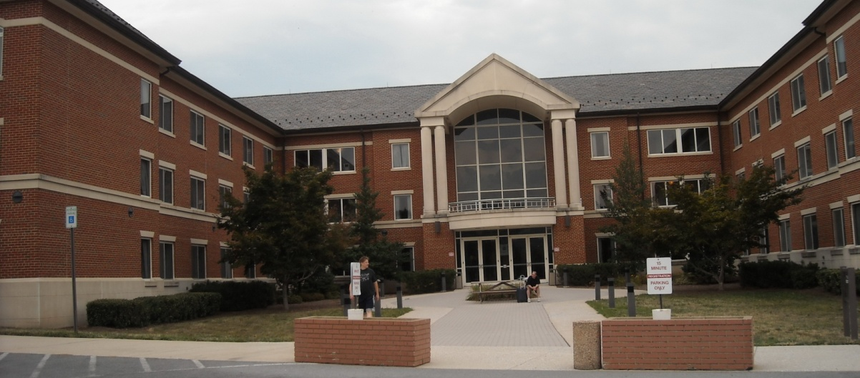
PIO training opportunities
•FEMA -Advanced Public Information Officer
  •Admission/campus
  information:
  301-447-1035
  •Course content information:
  Jennifer Pritchett,
  301-447-7270
  jennifer.pritchett@fema.dhs.gov

Slide 15
PIO training opportunities
•Local Emergency Management
•Local/regional Public Information Networks (PINs)

Slide 16
Mock new interviews
Junk yards
Dilapidated structures
Hoarding

Slide 17
PIO training opportunities
Questions?

